Slide 1
Team Status Report
Team Argus - 01/30/2015

Slide 2
Project Plan
Tracking through Architecture Design
Cost Analysis
Planned Cost = 372 hours
Actual Cost = 340 hours
Earned Value = 364.5 hours
CPI = 1.07
SPI = .98

Slide 3
ADS Progress
Incorporating changes based on feedback
incorporating a new “SDK Layer” in document
general clarification, spelling, and grammar
formatting
Unexpected setback: Ghost Formatting
Final submission submitted on Jan. 29th

Slide 4
Parts to Order
Resistors and LEDs
Arduinos
Leonardo
Micro
Everlight EL-PT204 Phototransistors
8-Bit Shift Registers and Counter Shift Registers

Slide 5
Arduino Project
2 Way Serial Communication
8-16bit Input and Outputs
Sending ASCII
ASCII to Binary Conversion to physical viewing

Slide 6
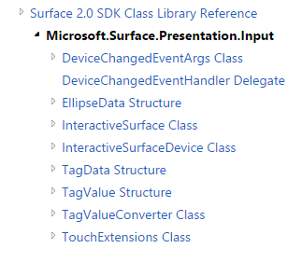
PixelSense Application
Surface 2.0 SDK
Blackjack Desktop Application.
Integrating it with PixelSense environment.
Input Libraries available

Slide 7

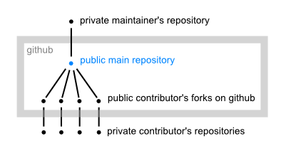
Repositories
Why we need one?
To store code hierarchically!
To share code!
To work on code together!
To resolve code conflicts!
and lot more!
Do we have one?
YES!

Slide 8
Future Work
Program PixelSense to display white light
Expand on Shamikul’s work
add photo transistor
read light from PixelSense
Get Started on Detail Design

Slide 9
Questions?
Fun Fact #77
Shamikul still believes in Santa Clause, just ask him where he got his new laptop.

